Slide 1
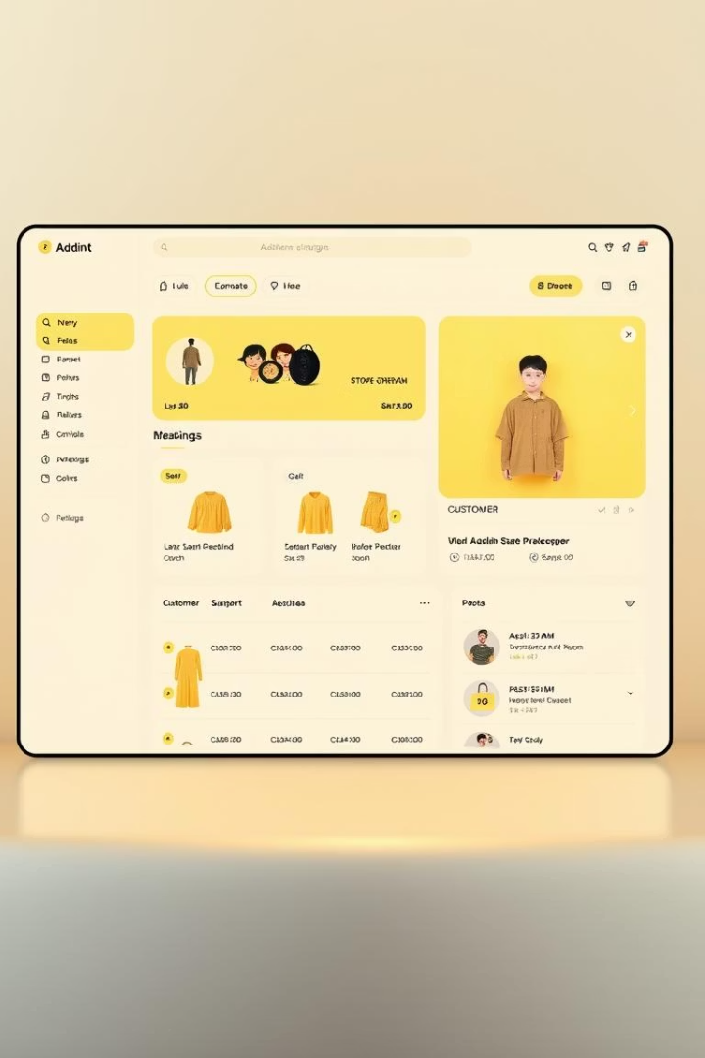
Shopegy E-Commerce Platform Overview
Shopegy is a modern online shopping platform made to give people in Egypt a better, faster, and easier shopping experience. It’s built to be smarter and more helpful than other e-commerce websites, with tools for both customers and store owners.
Shopegy also supports Egypt’s digital future by helping local businesses grow online and creating new job opportunities. It works hand in hand with the government’s plans to improve technology and support young entrepreneurs across the country.

Slide 2

Team members
Nour Elden Mahmoud
Atef Ayman Zahran
Zeyad Khaled Hassan
Andrew Ayman Abdo
Mohamed Bahgat Shawky
Ahmed Hafez

Slide 3

User Roles and Permissions
Role
Permissions
Admin
Manage products, view sales dashboard, assign user roles
Customer
Browse products, add to cart, checkout
The platform supports two primary roles: Admins who oversee product and user management, and Customers who interact with the product catalog and complete purchases.

Slide 4

Admin Features
Product Management
Sales Dashboard
Access real-time sales reports and identify top-selling products.
Add, edit, and delete products with images, pricing, and stock tracking.
User Role Management
Assign and manage admin and customer roles within the platform.

Slide 5

Functional Requirements
Product Browsing
Shopping Cart
Search, filter, and view detailed product information.
Add or remove items and adjust quantities easily.
Checkout
Secure payment processing via credit card or PayPal.

Slide 6
Non-Functional Requirements
Performance & Scalability
Security & Compliance
Usability
Page load under 500ms, support 100+ concurrent users, and handle 10,000+ products with efficient database indexing.
HTTPS, role-based access control, SQL injection prevention, and payment security.
Intuitive navigation for a seamless user experience.

Slide 7
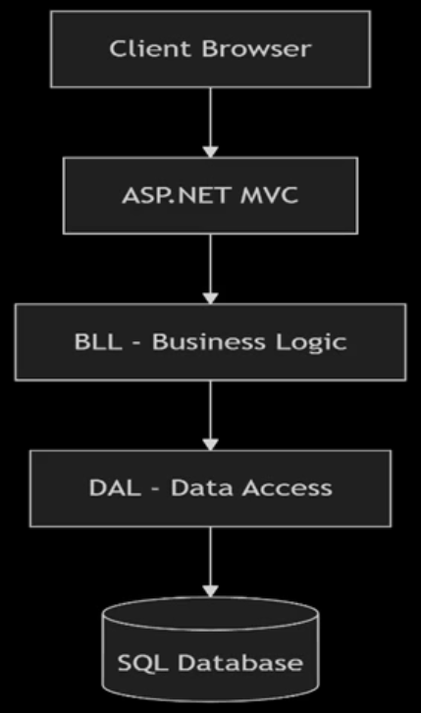
System Architecture and Database Schema
The architecture features a layered design with ASP.NET MVC backend, SQL Server database, and Bootstrap frontend for responsive UI.
The database schema supports product, user, order, and role management to ensure data integrity and efficient operations.

Slide 8
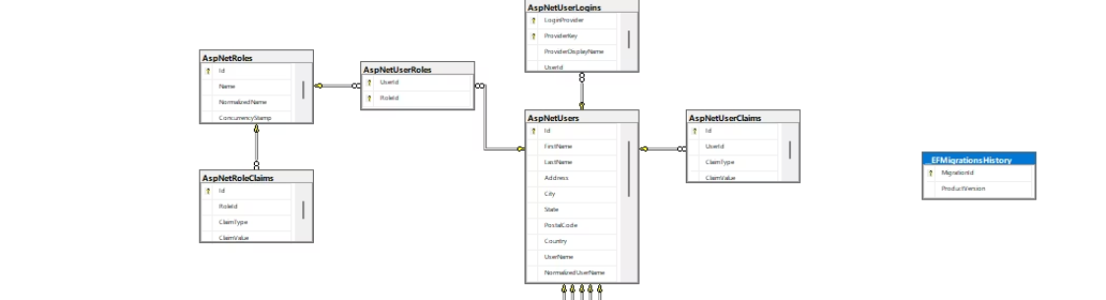
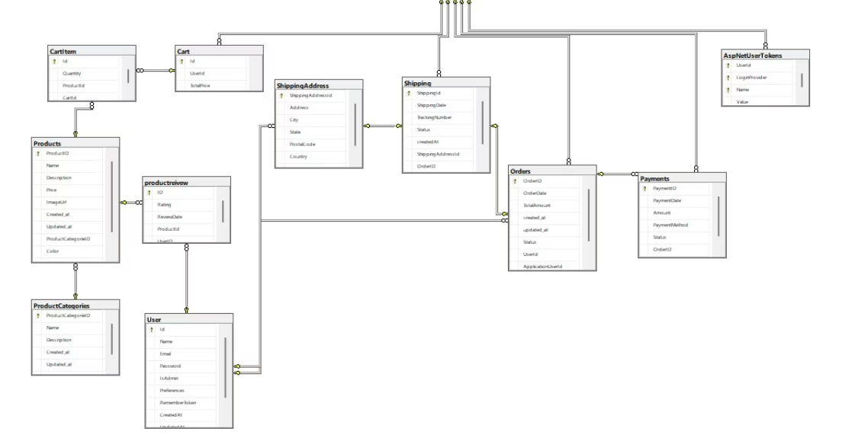
Database Relational model

Slide 9
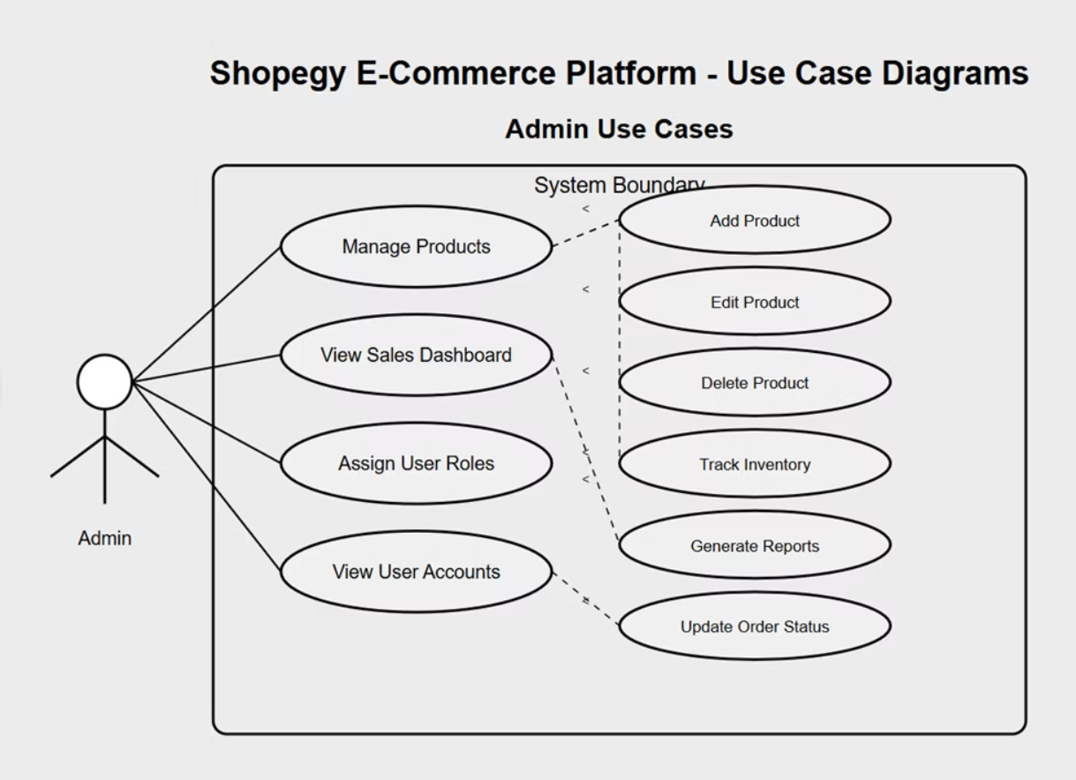
Use Case Diagrams (Admin)

Slide 10
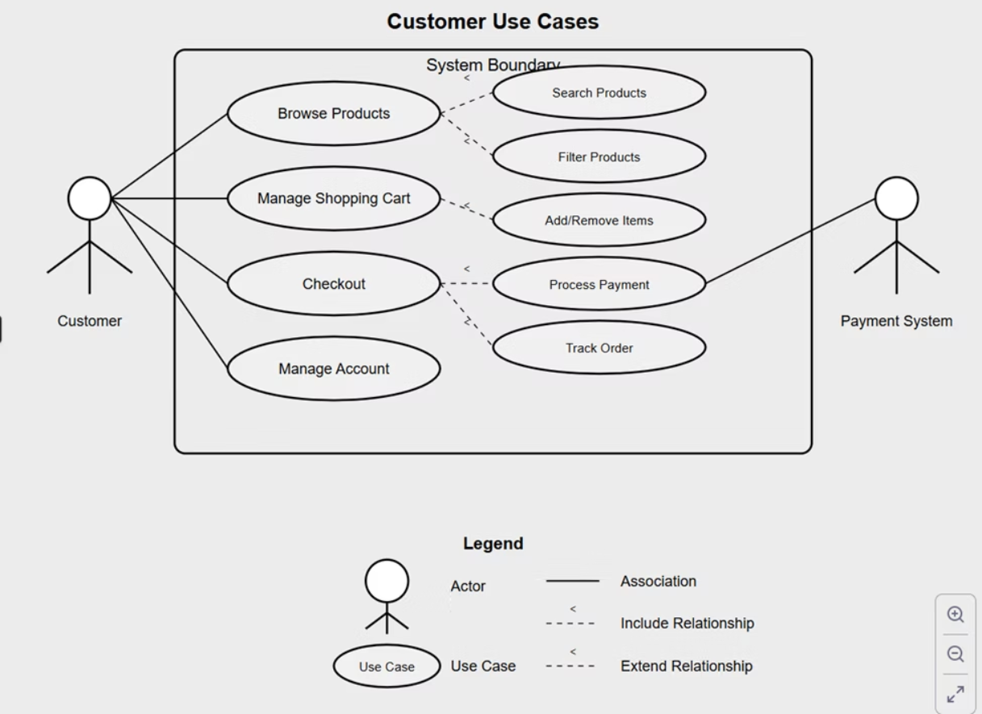
Use Case Diagrams (Customer)

Slide 11
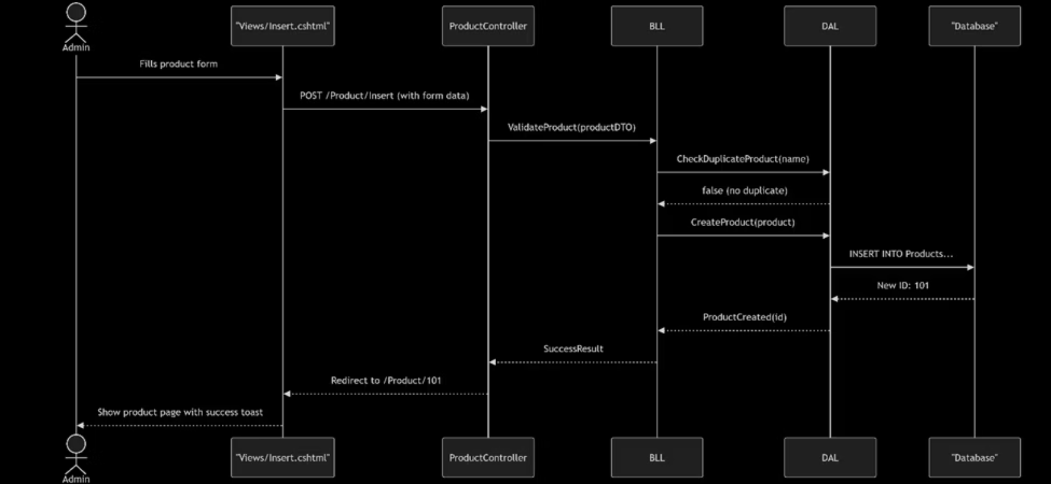
Sequence Diagrams (Admin)

Slide 12
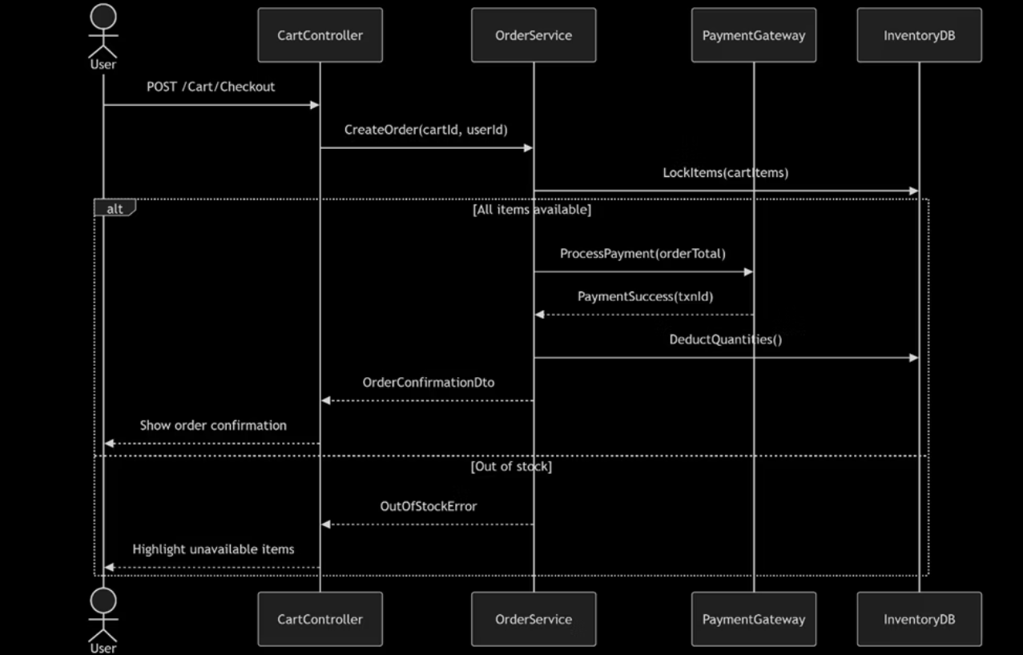
Sequence Diagrams (Customer)

Slide 13

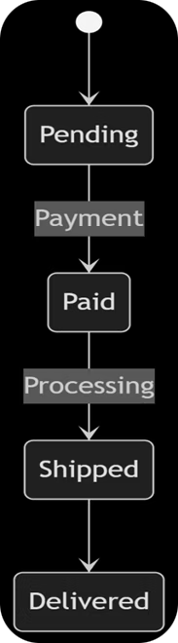
Order Lifecycle State Diagram
The order lifecycle includes states such as pending, processing, shipped, delivered, and cancelled. This ensures clear tracking and management of customer orders throughout the fulfillment process.

Slide 14




Risk Management and Future Enhancements
Payment Fraud
Mitigated by integrating fraud detection tools like Stripe Radar.
Database Overload
Handled through query optimization.
DDoS Attacks
Protected by Cloudflare services to ensure platform availability.
Future enhancements include AI-driven product recommendations and multi-language support to improve user experience and global reach.

Slide 15
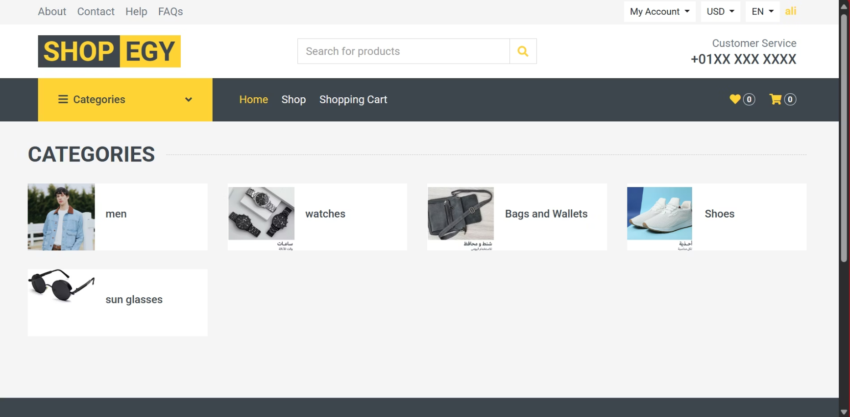
Customer Views

Slide 16
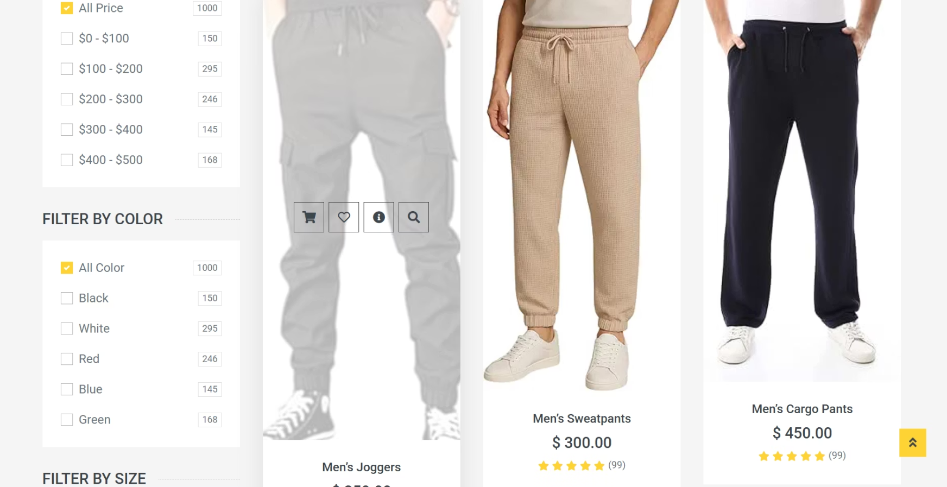
Customer Views

Slide 17
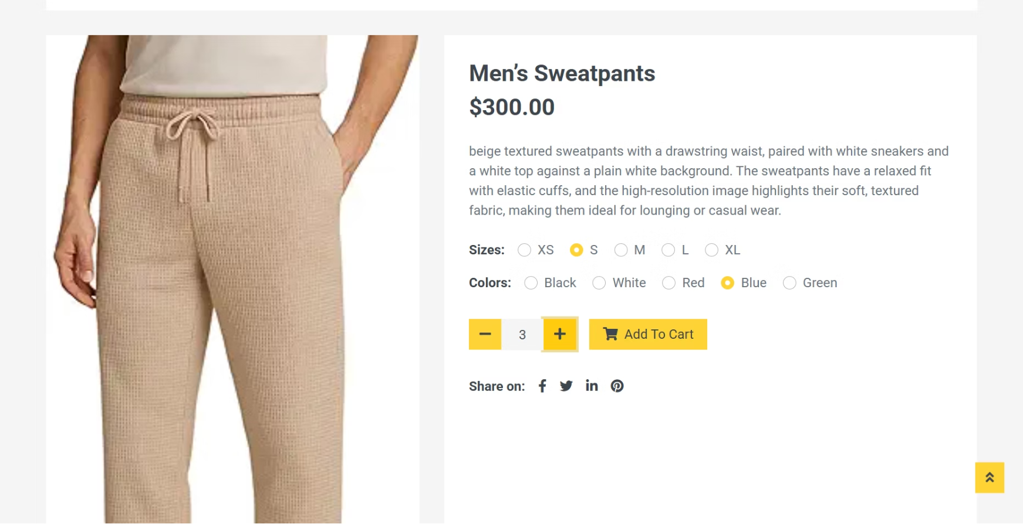
Customer Views

Slide 18
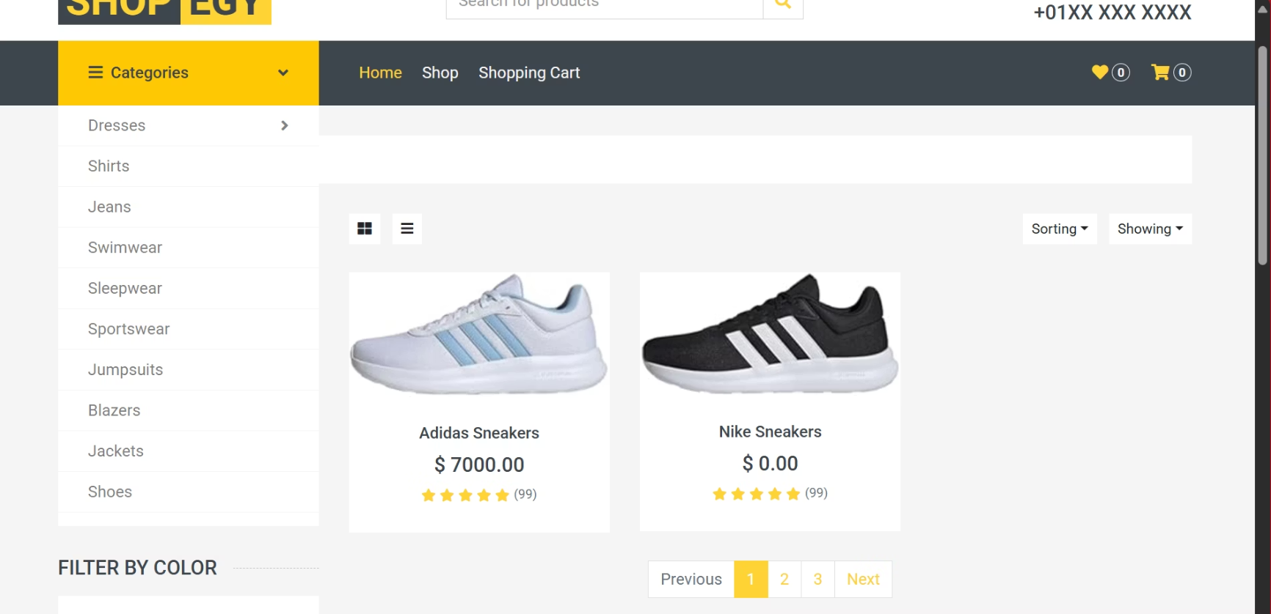
Customer Views

Slide 19
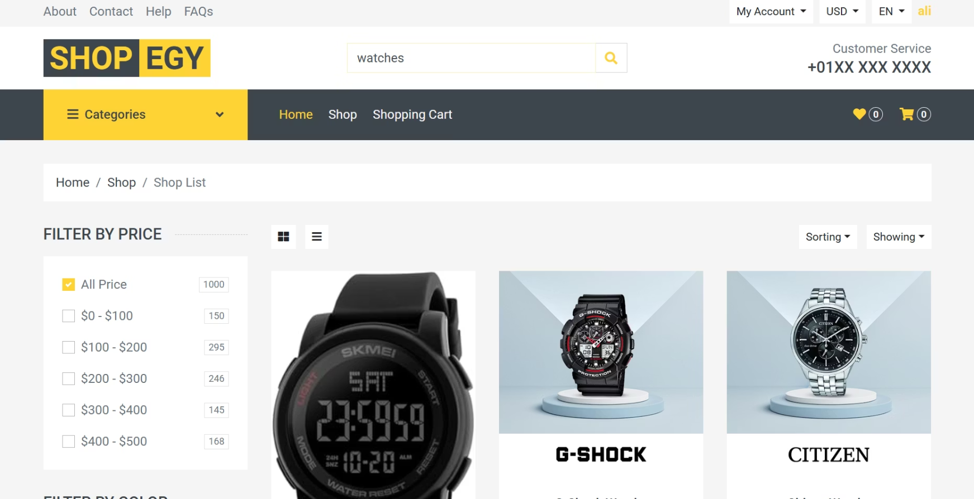
Customer Views

Slide 20
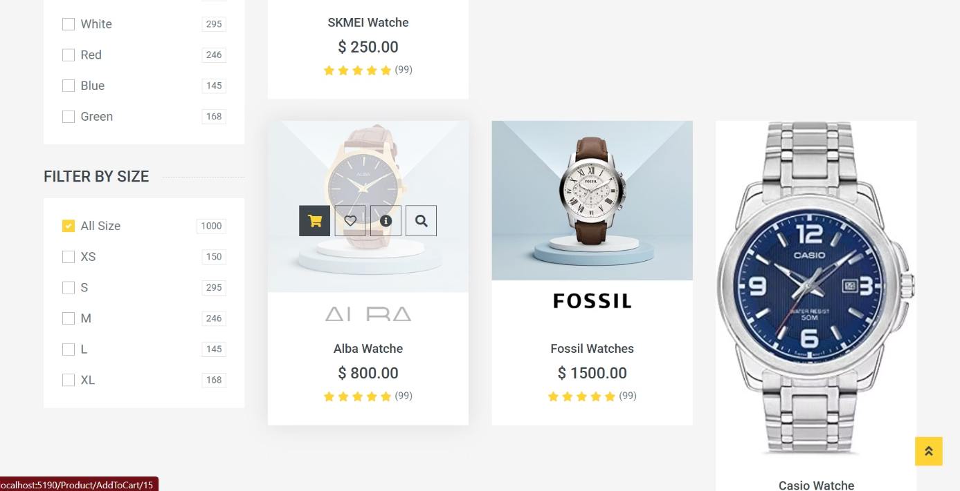
Customer Views

Slide 21
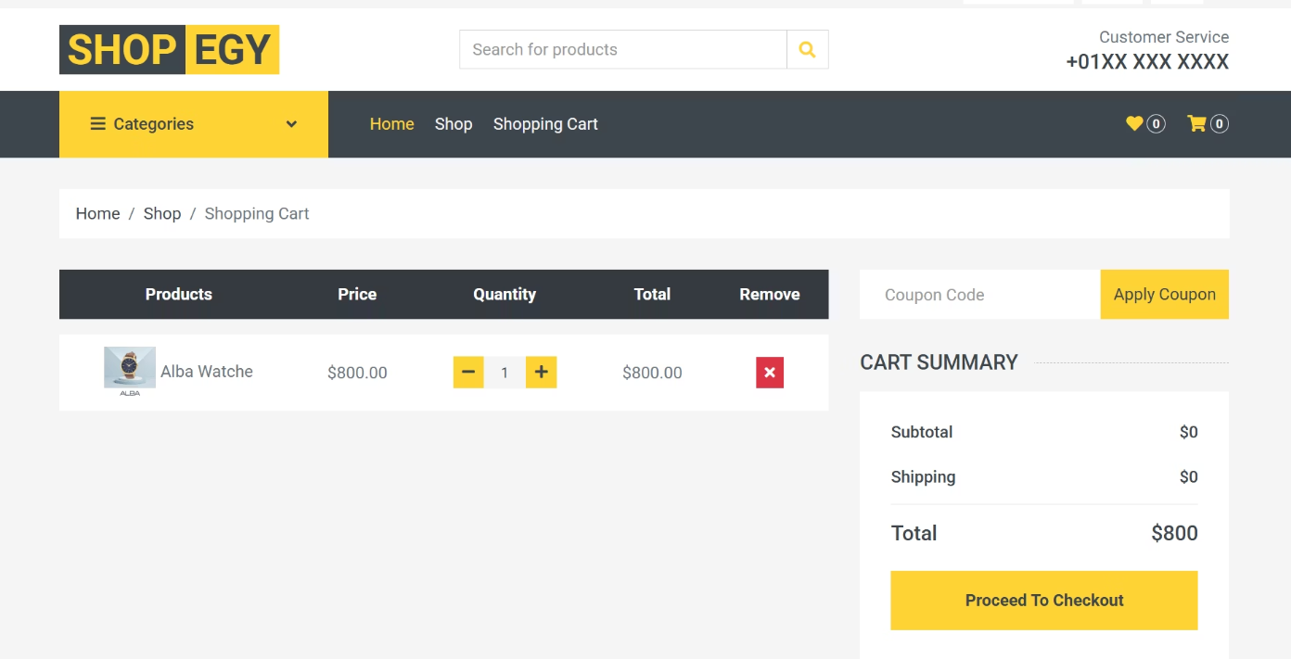
Customer Views

Slide 22
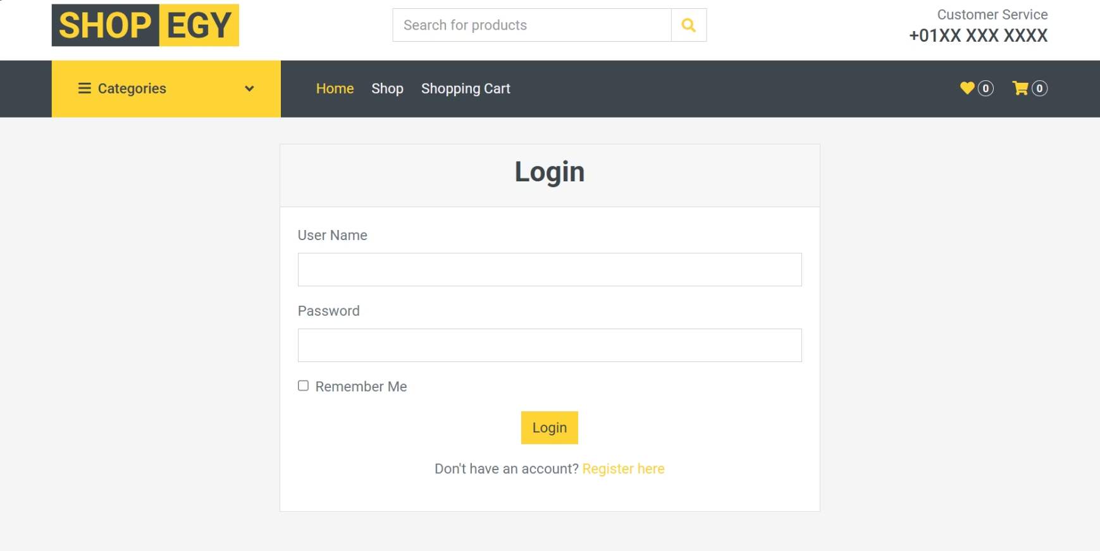
Customer Views

Slide 23
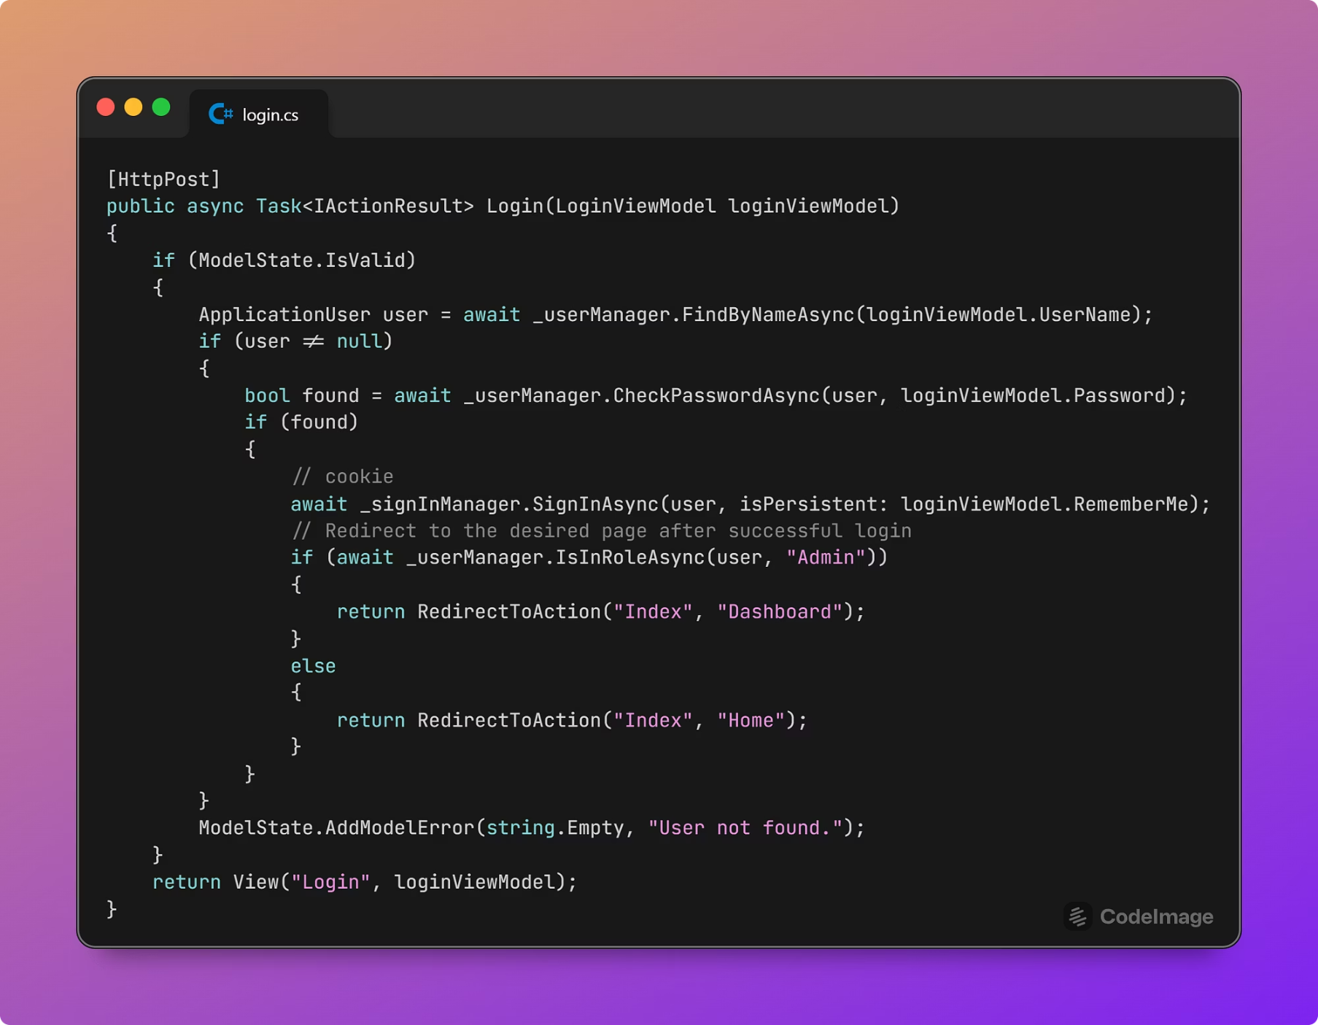
Login snippet

Slide 24
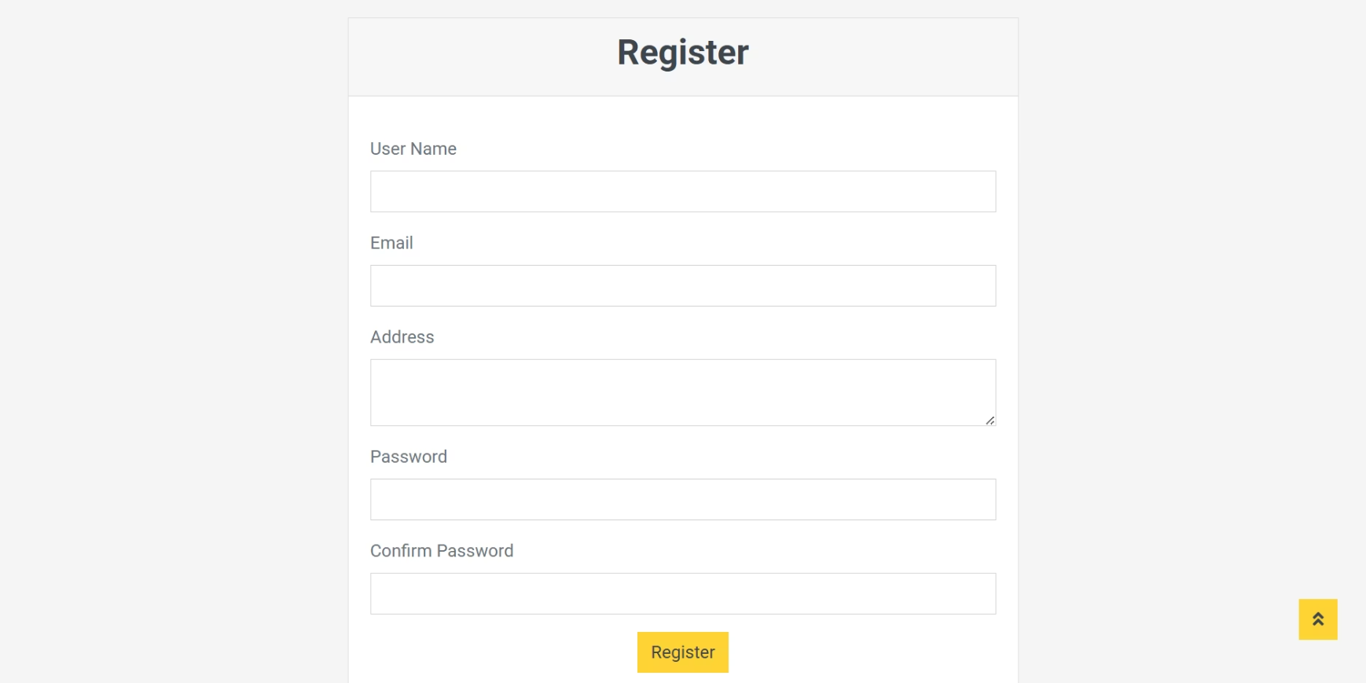
Customer Views

Slide 25
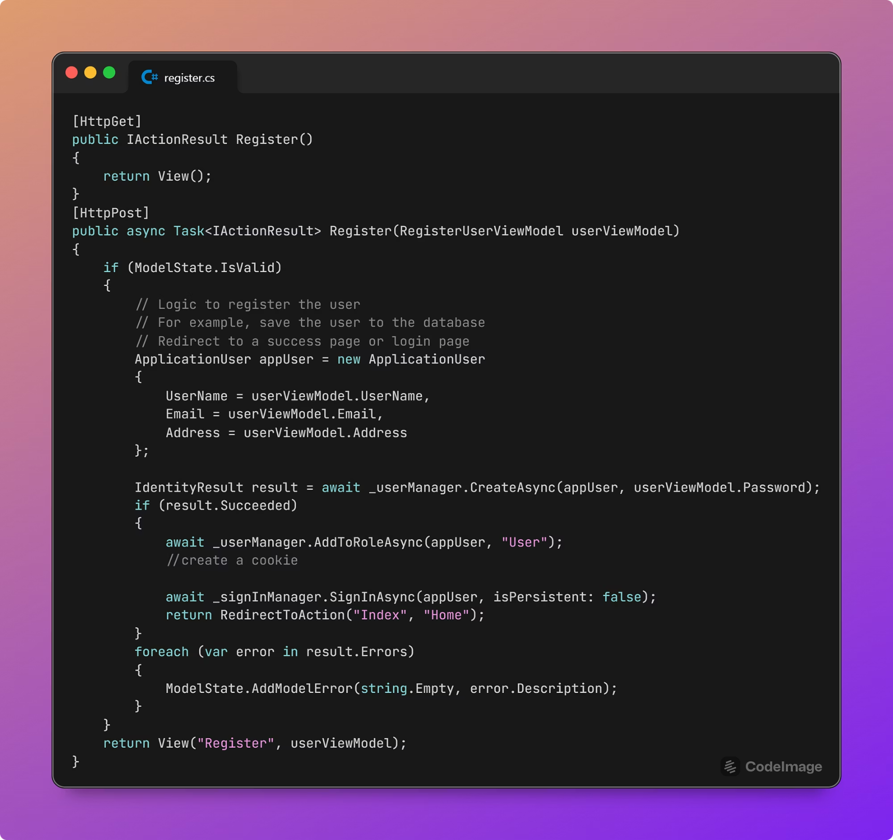
Customer Views

Slide 26
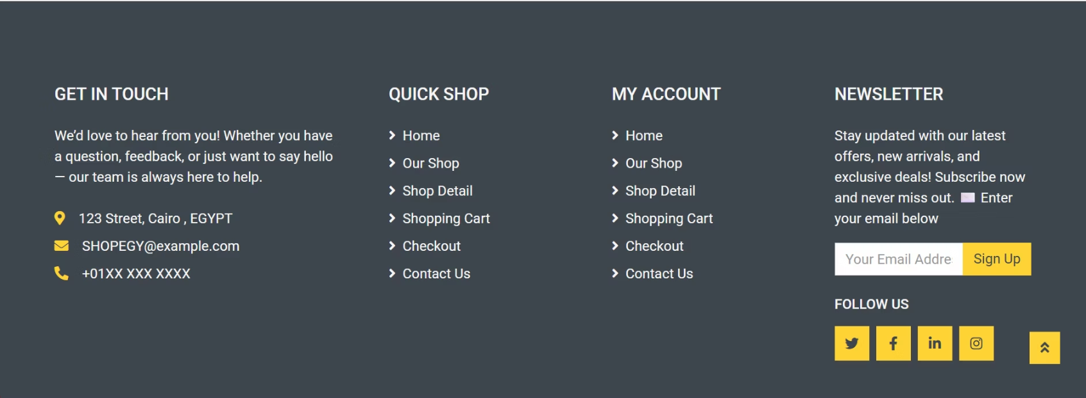
Customer Views

Slide 27
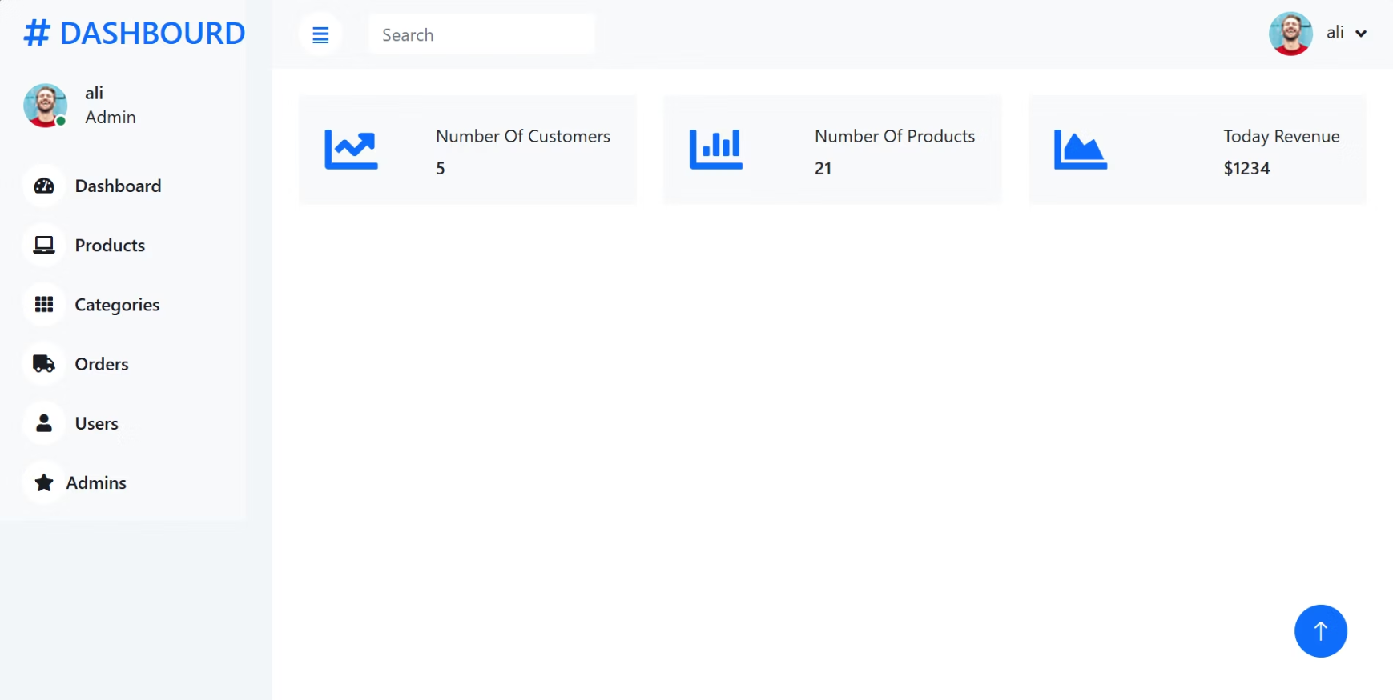
Admin Views

Slide 28
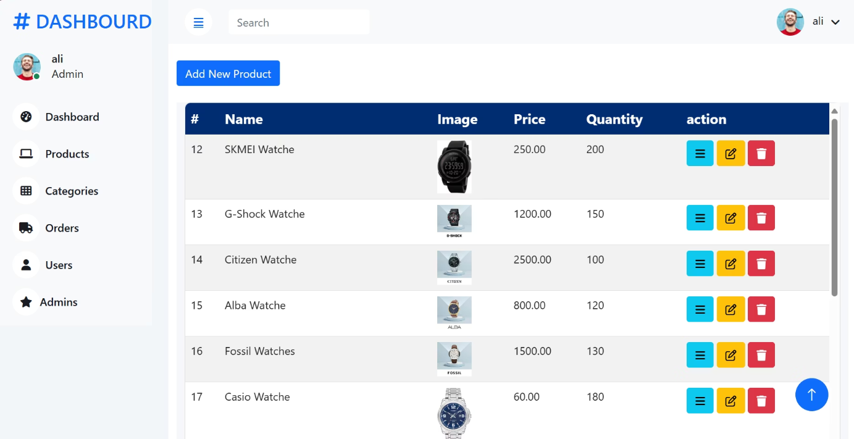
Admin Views

Slide 29
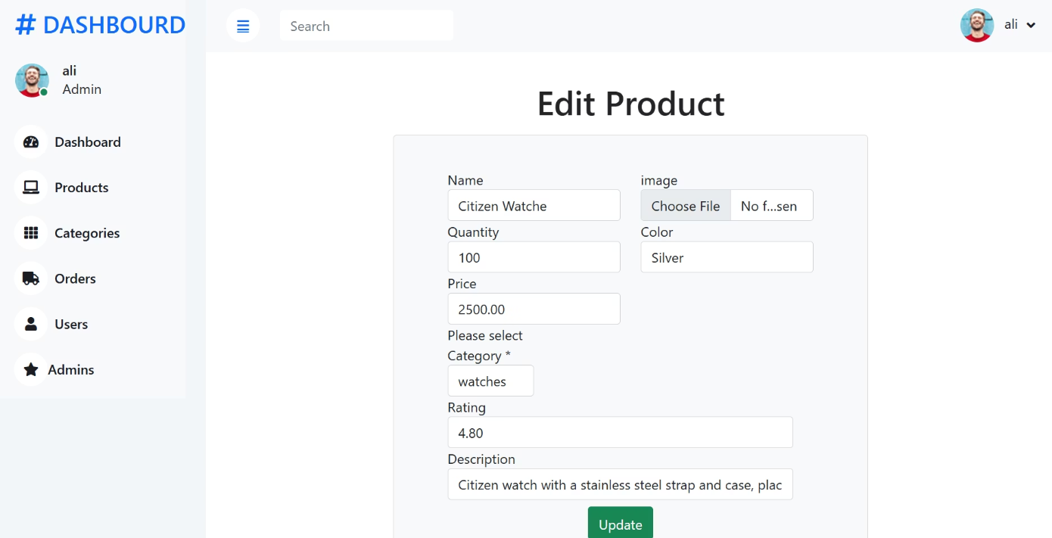
Admin Views

Slide 30
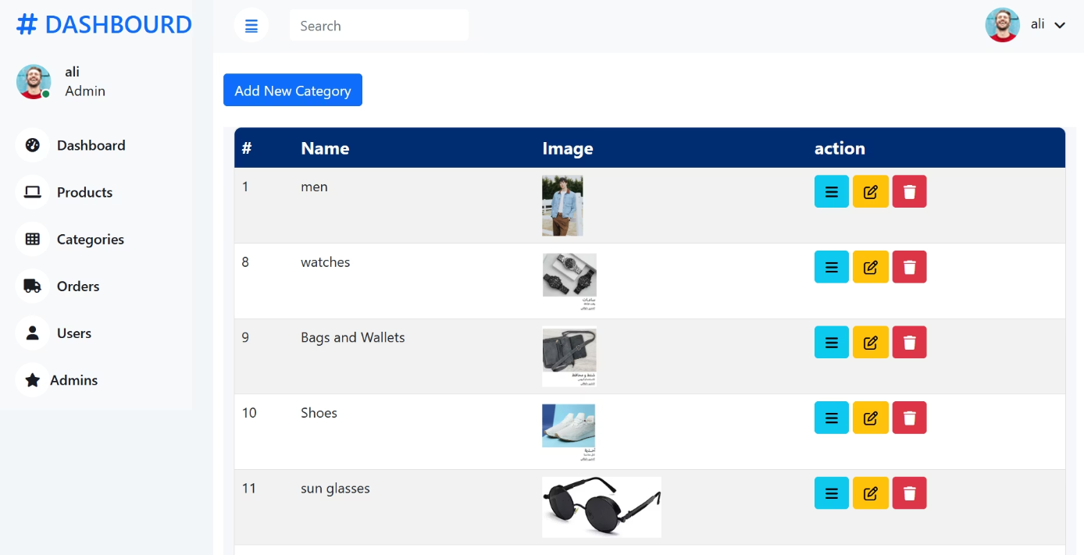
Admin Views

Slide 31
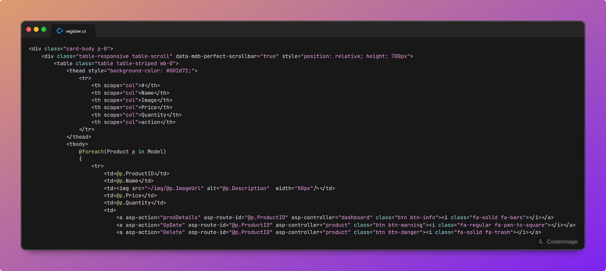
Admin Views

Slide 32
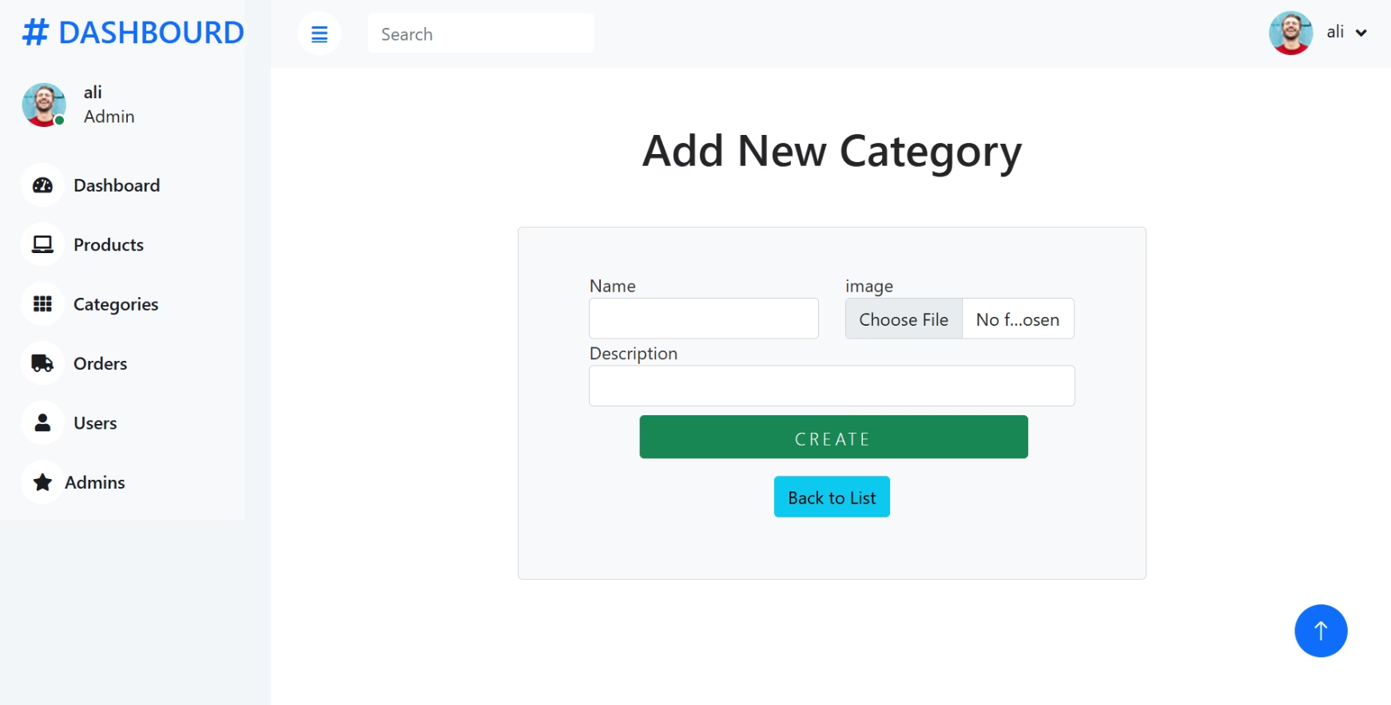
Admin Views

Slide 33
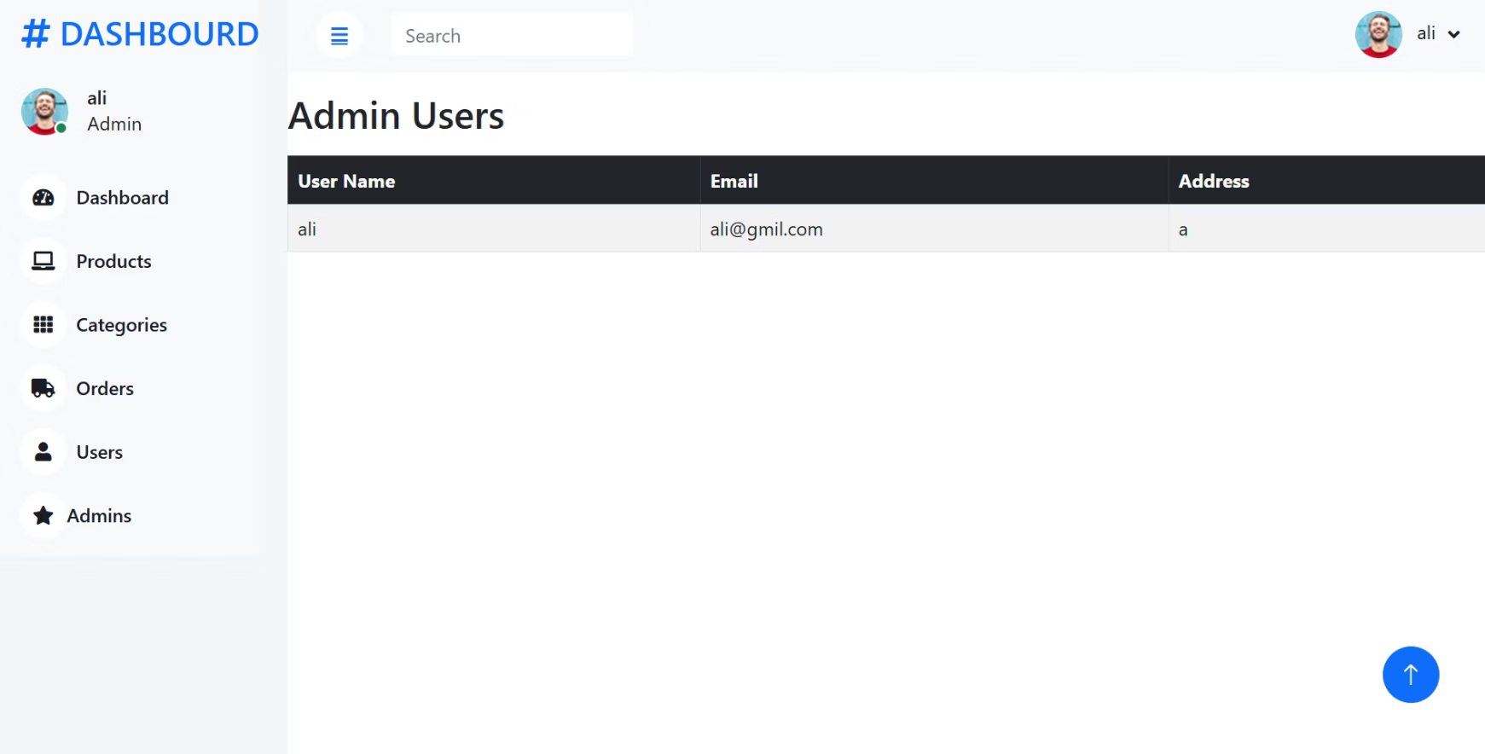
Admin Views

Slide 34
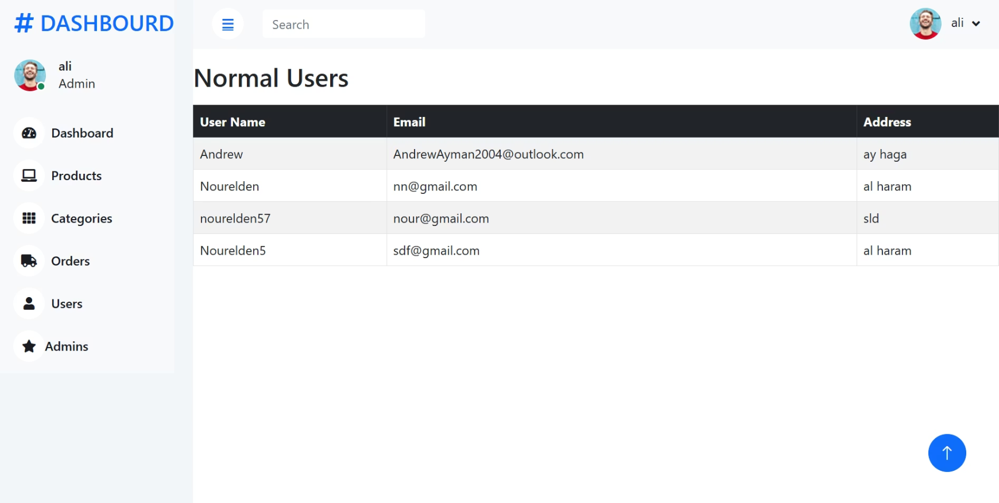
Admin Views

Slide 35
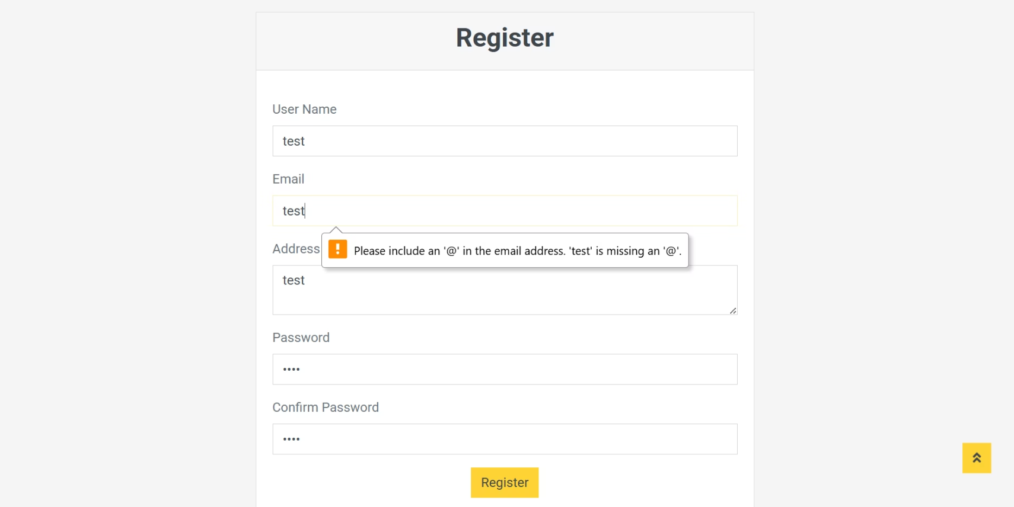
Functionality testing (register)

Slide 36
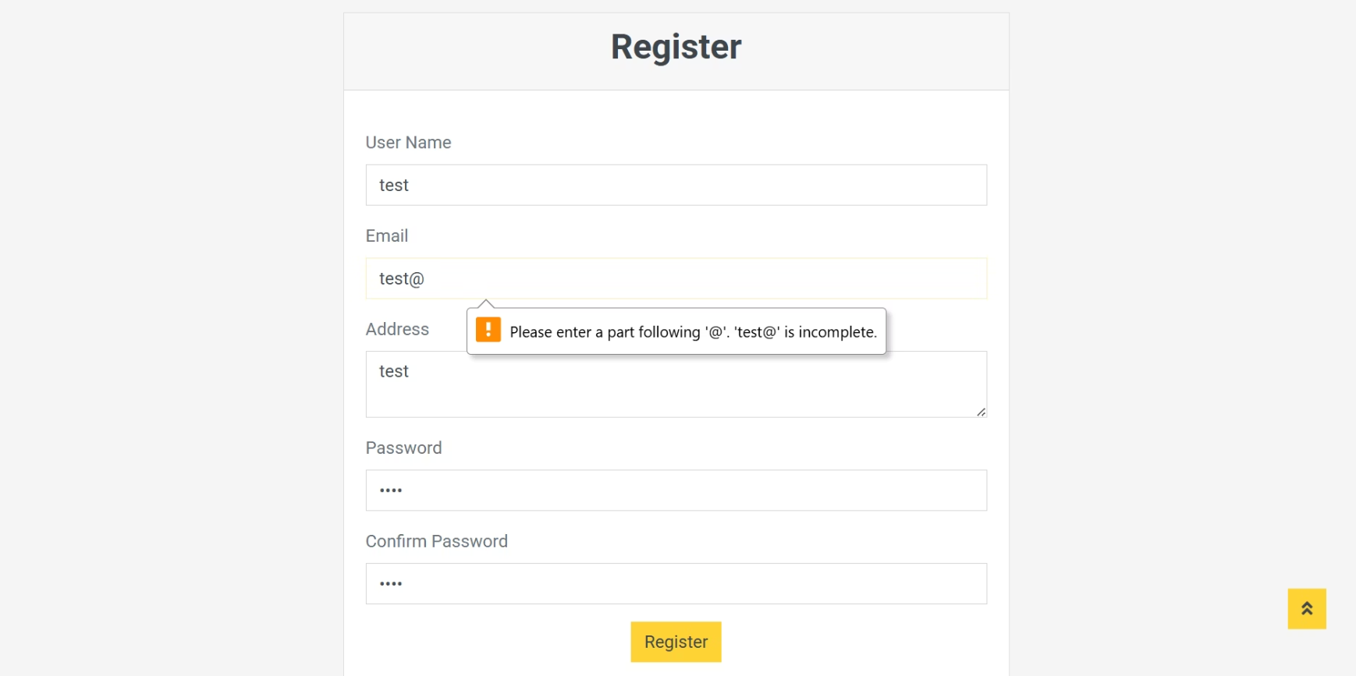
Functionality testing (register)

Slide 37
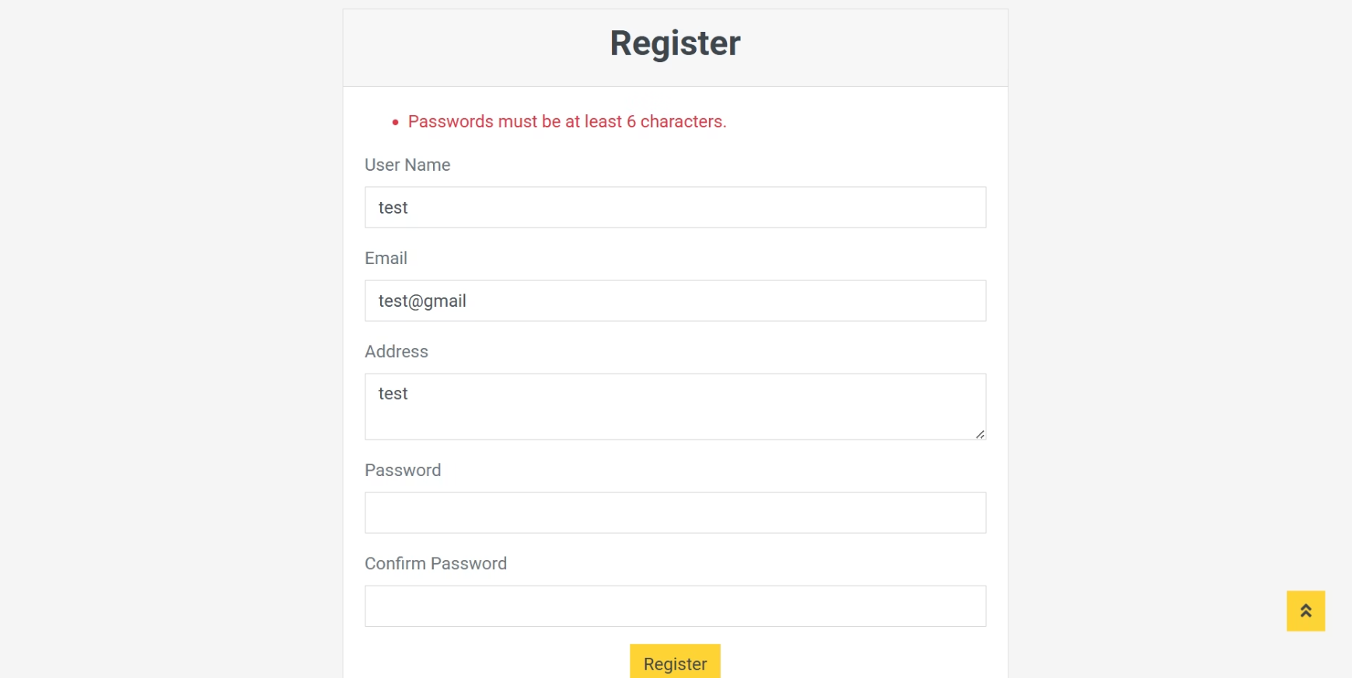
Functionality testing (register)

Slide 38
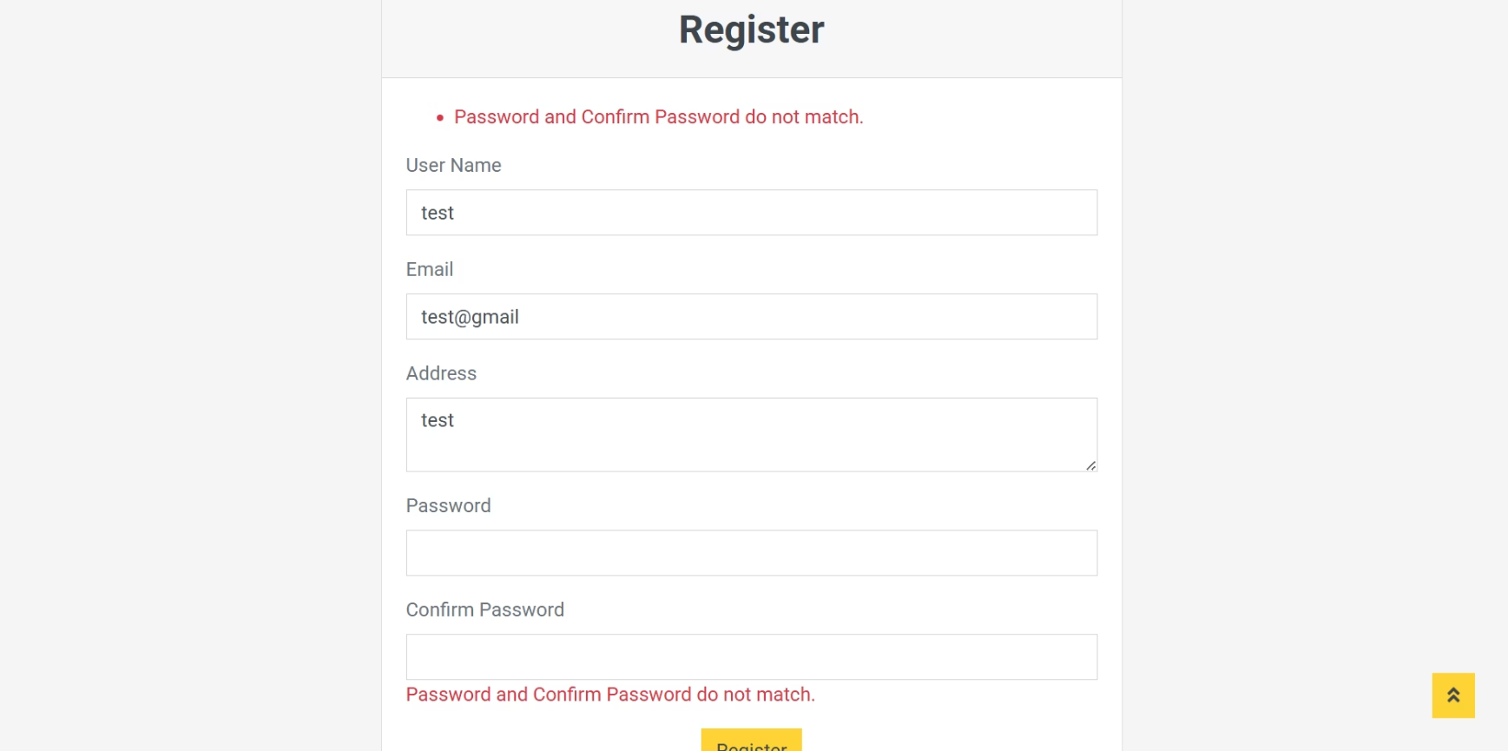
Functionality testing (register)

Slide 39
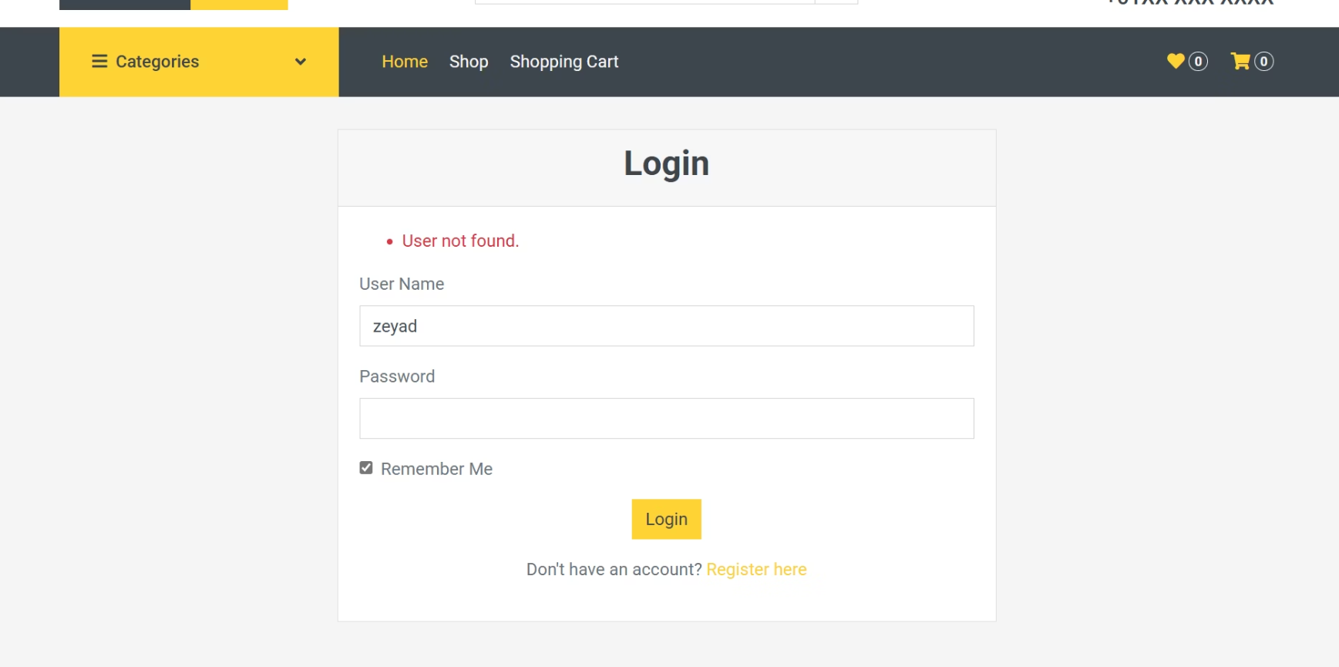
Functionality testing (Login)

Slide 40








Functionality Testing Overview
Focused on critical areas: user registration and login processes.
Register Feature
New User Registration
Validated user input handling and error responses.
Tested success messages and user data storage.
Error Handling
Login Functionality
Ensured clear feedback for invalid inputs and security checks.
Checked authentication and session management.

Slide 41
Thank you!

